Slide 1
Characterizing a Spring Pendulum with Monte Carlo Methods
Dawn sargent and Mattison Johnson
Fairmont state university
April 26, 2018

Slide 2






Special thanks

Slide 3
Spring pendulum

Slide 4


Monte carlo
Useful for numerically modeling physics-related problems
Especially valuable in a high dimensional parameter space
Identifies meaningful ranges for each parameter
Algorithm randomly chooses from each range
Able to obtain results very close to the actual expected outcomes and their associated probabilities
Law of Large Numbers

Slide 5
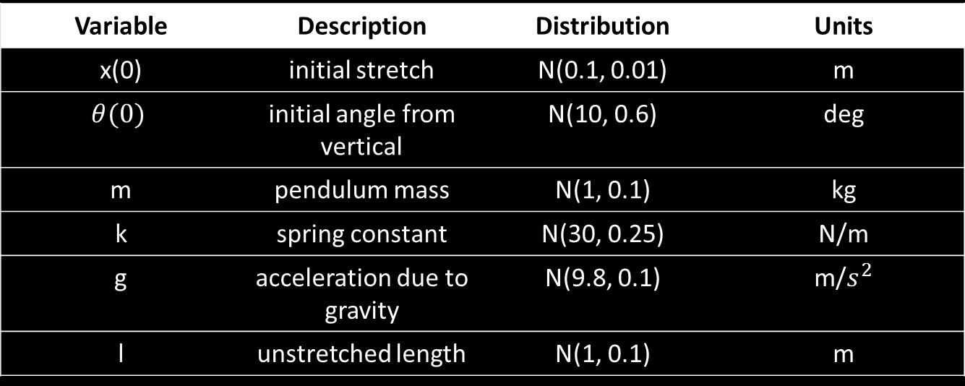

The Problem
What makes a spring pendulum result in chaotic motion?
$$x^{′′}+ \frac{k}{m}x −\left(l+x\right){θ^{′}}^{2}+gcos\left(θ\right)=0$$
$$θ^{′′}+ \frac{gsin\left(θ\right)+2x′θ′}{l+x}=0$$
Variable | Description | Distribution | Units
x(0) | initial stretch | N(0.1, 0.01) | m
$$θ(0)$$ | initial angle from vertical | N(10, 0.6) | deg
m | pendulum mass | N(1, 0.1) | kg
k | spring constant | N(30, 0.25) | N/m
g | acceleration due to gravity | N(9.8, 0.1) | m/$s^{2}$
l | unstretched length | N(1, 0.1) | m

Slide 6
Differential equations
Definition
Examples
Any equation which contains derivatives, either ordinary derivatives or partial derivatives.
First order: Highest derivative that appears is a first order derivative
Second order: y’’ appears
Linear: y, y’, and y’’ are not squared, cubed, etc, and their product does not appear
y’’ + y = 0
y’’ = -y
If y = sin(x), then y’ = cos(x) and y’’ = -sin(x).
If y = cos(x), then y’ = -sin(x) and y’’ = -cos(x).
Thus, sin(x) and cos(x) are solutions.
y’’ - y = 0
y’’ = y
If y = e^{x}, then y’ = e^{x} and y’’ = e^{x}.
If y = e^{-x}, then y’ = -e^{-x} and y’’ = e^{-x}.
Thus, e^{x} and e^{-x} are solutions.

Slide 7
Converting to System of 1st order equations
1st equation
2nd equation

Slide 8
Code
scipy.integrate.odeint
Integrate a system of ODEs
dy/dt = func(y, t0, t, args, … )
def pend(I, t, m, k, l, g):
dy1dt = I[1] # y1' = y2 = x’
dy2dt = (-k/m)*I[0] + (l+I[0])*(I[3])**2 + g*math.cos(I[2]) # y2' = x"
dy3dt = I[3] # y3' = y4 = theta’
dy4dt = (-g*math.sin(I[2]) - (2.0*I[1]*I[3])) / (l+I[0]) # y4' = theta"
return [dy1dt, dy2dt, dy3dt, dy4dt]
…
t = np.linspace(0, totTime, numSteps) # time array
…
# Calling odeint
results = DataFrame(integrate.odeint(pend, initial_conditions, t, args=(mass, spring, length, gravity)))

Slide 9

Existence & UNIQUENESS
Taken from pg. 350 of The Theory of Differential Equations: Classical and Quantitative (2nd ed.) by W. Kelley and A. Peterson
Picard-Lindelof Theorem:
Assume that f is a continuous n-dimensional vector function of the rectangle
Q := {(t,x) : t₀ ≤ t ≤ t₀ + a, ‖x-$x_{0}$‖ ≤ b}
and assume that f(t,x) satifies a uniform Lipschitz condition with respect to x on Q. Let
M := max{ ‖ f(t,x) ‖ : (t,x) $∈$Q }
and
$α$ := min{a, $\frac{b}{M}$}.
Then the initial value problem has a unique solution x on [t₀, t₀ + $α$].
Furthermore,
‖x(t) - $x_{0}$‖ ≤ b,
for t $∈$ [t₀, t₀ + $α$].

Slide 10
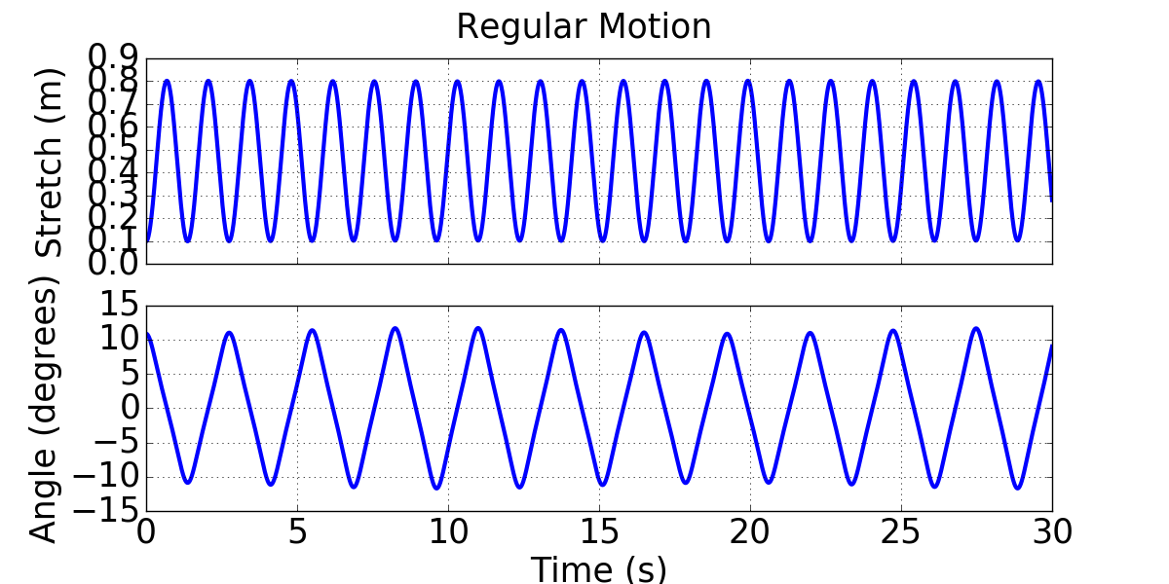
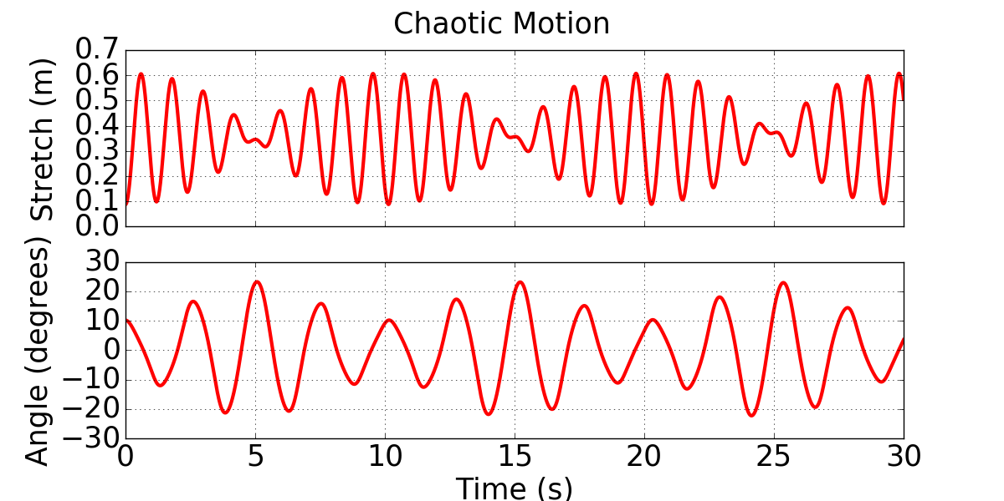

Performance Metric
In order to identify what parameters affect the success of a trial, we must first determine what will define a success versus a failure.
Performance metric: If the max angle exceeds 21$°$, it is chaotic.
Motion | Gravity | Initial Angle | Initial Stretch | Length | Mass | Spring
Regular | 9.82 | 6.31 | 0.121 | 0.8044 | 1.207 | 30.131
Chaotic | 9.73 | 10.16 | 0.088 | 1.065 | 1.058 | 29.79

Slide 11
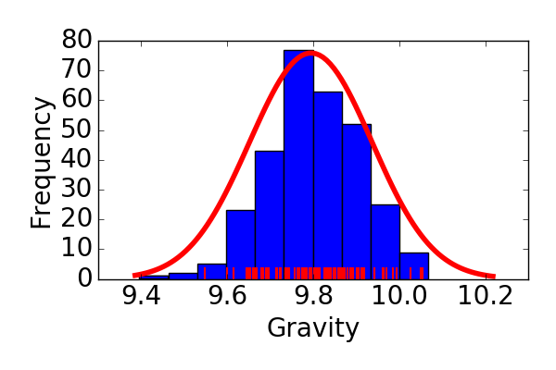
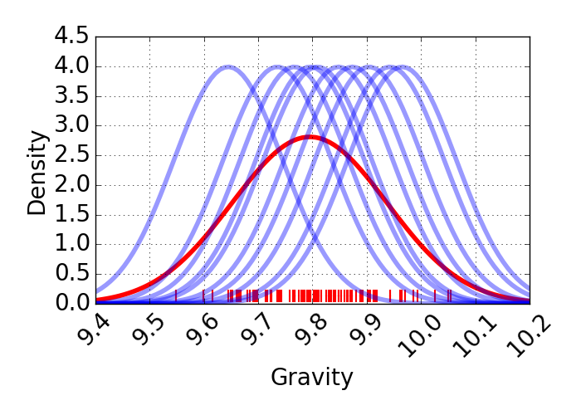
Kernel density estimate
What is a kernel density estimate?

Slide 12
KDE

Slide 13
K-Nearest neighbors
What is the k-nearest neighbor method?

Slide 14
KNN

Slide 15
Optimization
Split the data
75% training
Fit the classifier
25% testing
Get predictions
Compare

Slide 16
Accuracy
Parameters | Accuracy
Mass vs Length | 86.94%
Mass vs Initial Stretch | 83.03%
Mass vs Initial Angle | 78.70%
Mass vs Spring | 78.32%
Mass vs Gravity | 78.31%
Length vs Initial Stretch | 70.97%
Initial Angle vs Length | 65.95%
Length vs Spring | 65.84%
Length vs Gravity | 65.81%
Initial Angle vs Initial Stretch | 65.50%
Initial Stretch vs Spring | 65.18%
Initial Stretch vs Gravity | 65.11%
Initial Angle vs Spring | 58.56%
Initial Angle vs Gravity | 58.53%
Spring vs Gravity | 57.94%

